Slide 1
SPARSE REPRESENTATION FOR COLOR IMAGE RESTORATION
Julien Mairal, Michael Elad, Guillermo Sapiro
- Harshita Gandra
- Sai Thanmayee Regati

Slide 2
OUTLINE
Abstract
Introduction
Sparse Representation
Greyscale K-SVD Denoising Algorithm
Sparse Color Image Representation
Experimental Results
Conclusion
Future Scope

Slide 3
ABSTRACT
The design of well adapted dictionaries for images has been a major problem.
The K-SVD has been recently proposed for this task and shown to perform well for various grayscale image processing tasks.
This paper addresses the problem of learning dictionaries for color images and extend the K-SVD based grayscale image denoising algorithm.
This can also be applied for color image denoising, demosaicing and inpainting.

Slide 4
INTRODUCTION
The model used to describe the data is very important when developing algorithms for processing these signals.
The Sparseland model is an emerging and powerful model to describe the signals based on the sparsity.
Dictionaries can either be chosen from a known set of dictionaries (Wavelet, Curvelets…) or Learn the dictionary.
The main aim of this paper is to extend the K-SVD algorithm for grayscale image denoising and demonstrating the success of the proposed scheme in demosaicing and inpainting.

Slide 5

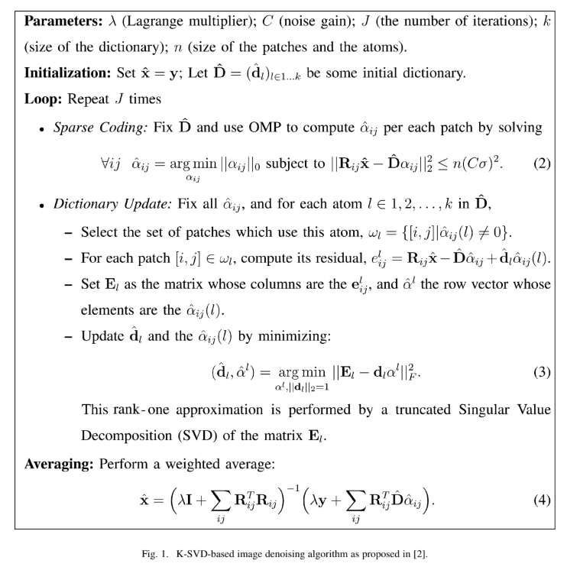
Grayscale K-SVD Denoising Algorithm

Slide 6
SPARSE COLOR IMAGE REPRESENTATION
Denoising of Color Images
Extension to Nonhomogeneous Noise
Color Image Inpainting
Color Image Demosaicing

Slide 7
DENOISING OF COLOR IMAGES
Simplest way to extend the K-SVD algorithm to the denoising of color images is to denoise each signal channel using a separate algorithm with possibly different dictionaries.
But our goal is to make use of learning capabilities of K-SVD algorithm to capture the correlation between different color channels.
We can make use of different color spaces in image denoising but we will stay with original RGB color space.
One of the reason to stick with RGB is color conversions changes the structure of noise and another motivation is that digital cameras capture images and add noise within their space.

Slide 8
DENOISING OF COLOR IMAGES
Here we make use of dictionaries with 256 atoms and patches of size 8 x 8.
Directly applying K-SVD algorithm on (3-D) patches of size 8 x 8 x 3 with 256 atoms leads to better results than denoising each channel separately.
However this direct approach produces artifacts.

Slide 9
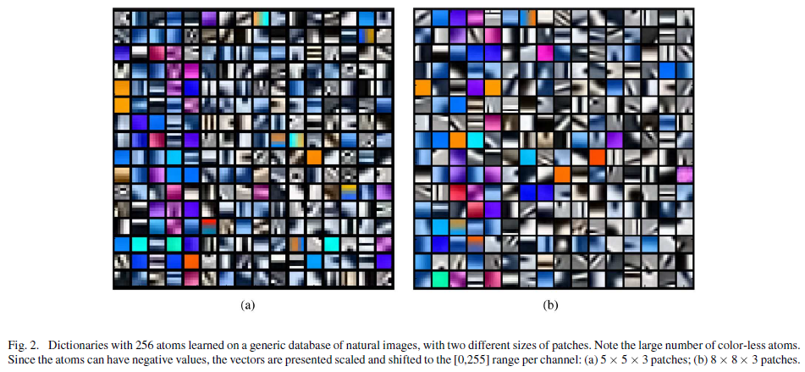
DENOISING OF COLOR IMAGES

Slide 10
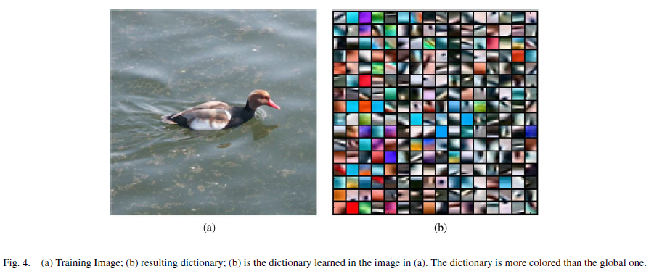
DENOISING OF COLOR IMAGES

Slide 11


DENOISING OF COLOR IMAGES
In order to reduce the problem of artifacts and overfitting, we define a new inner product to be used in OMP step.
Consider y and x are two patches written as column vectors (R, G, B)^{T}
where
Here, J_{n} n x n matrix filled with ones
γ is new parameter which can be turned to increase or discard this
correction (we empirically fixed γ = 5.25)

Slide 12
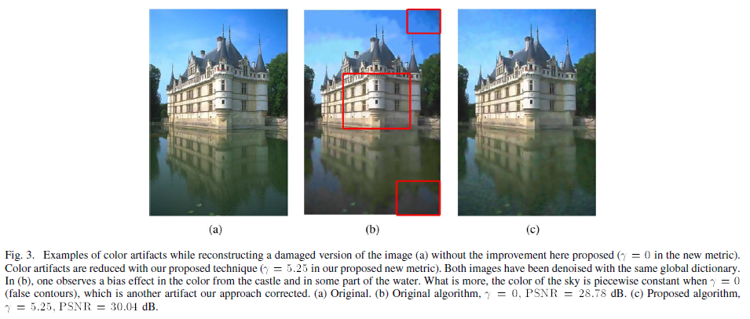
DENOISING OF COLOR IMAGES

Slide 13

DENOISING OF COLOR IMAGES
Implementation of above ideas follows from the simple fact that
with γ = 2a + a²
Thereby, scaling each patch and each atom of dictionary by multiplying them by I + a/nK and tacking into account a normalization factor which leads to straightforward implementation of OMP with new inner product.

Slide 14
EXTENSION TO NONHOMOGENEOUS NOISE
Nonuniform noise across channels is a very important and common problem in digital cameras.
Here, we concentrate on removing white gaussian noise but with different standard deviation for each pixel channel.
We consider case of grayscale images
where σ_{p} > 0 (σ_{p} deviation of noise at pixel p)
we assume σ value is known
We need to introduce a stopping criteria so that the algorithm doesn’t retrieve the noise.
Is scaling the data so that deviation of noise becomes uniform is correct ?

Slide 15
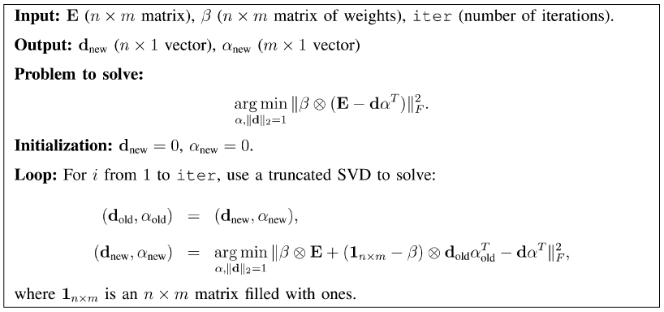
EXTENSION TO NONHOMOGENEOUS NOISE
We make use of β vector composed of weights for each pixel to approximate the non-scaled data using a different metric for each patch where noise would have a sphere structure.

Slide 16
COLOR IMAGE INPAINTING
It is an art of modifying and image in an undetectable form and often refers to filling in of hole of missing information in the images.
Holes smaller than 10 x 10 pixels are addressed successfully with the algorithm.
Here, we have two possibilities
- If we have both noise and missing information we can use previous
model.
- If we only have missing information we change the OMP so that it
runs for not more than fixed number of iterations and then we use
the information to reconstruct images to fill inn the holes.

Slide 17
COLOR IMAGE INPAINTING
There are two problems
- Use of unnatural atoms to fill the holes while reconstructing the
images.
- Another problem occurs when coefficient matrix follows a regular
pattern resulting in over fitting.
To overcome the first problem we initialize the algorithm with a global dictionary.
To overcome the second problem holes follow a repetitive pattern.

Slide 18
COLOR IMAGE DEMOSAICING
The problem of color demosaicing consists of reconstructing a full resolution image from raw data produced by a common colored-filtered sensor.
In order to address this problem we use the modified K-SVD algorithm that deals with nonuniform noise and an adaptive dictionary learned with low patch sparsity to avoid over-fitting.
Although color demosaicing is becoming less relevant with on-going development of sensor and camera technology.
It helps in testing the effectiveness of different image models and image processing algorithms.

Slide 19
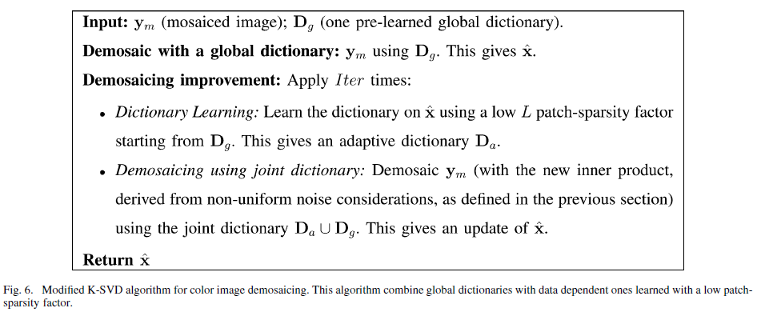
COLOR IMAGE DEMOSAICING

Slide 20
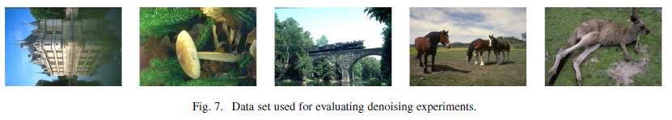
EXPERIMENTAL RESULTS
Denoising Color Images
- First we trained some dictionaries with different sizes of atoms on
200 000 patches taken from a database of 15000 images with patch
sparsity L=6.
- We choose to evaluate our algorithm on some images from Berkeley
segmentation database and for all our experiments we fixed the
number of iterations to be 20 and the results are tabulated.

Slide 21
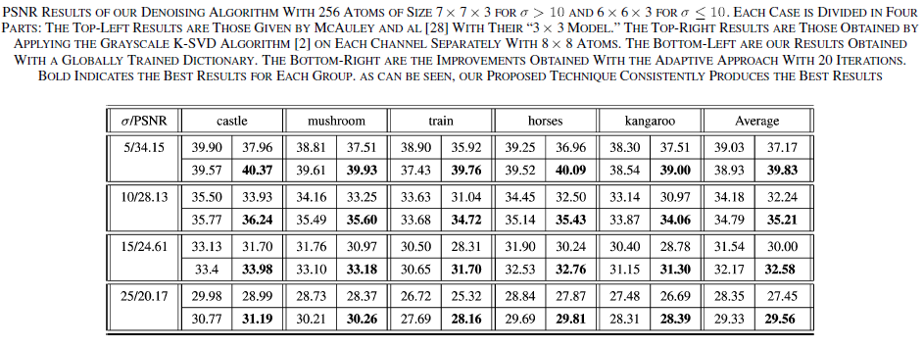
EXPERIMENTAL RESULTS

Slide 22
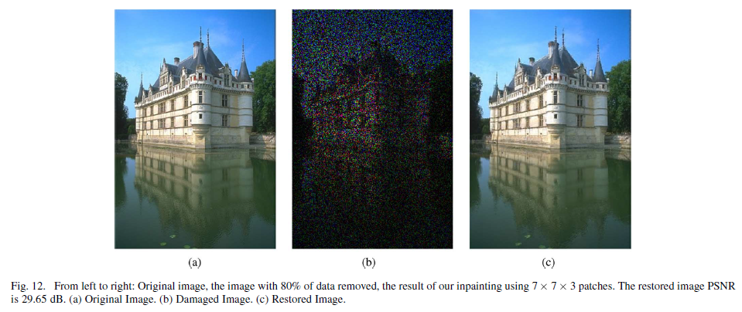
EXPERIMENTAL RESULTS
Inpainting Color Images

Slide 23
CONCLUSION
Grayscale K-SVD algorithm is more robust towards dimensionality increase.
Results of small patches different from large patches.
Finds correlation between different RGB channels.

Slide 24
FUTURE SCOPE
Multi-scaling
Parallelization
Reduction of Overlapping

Slide 25
Thank You !

